Slide 1

Cursor AI 编程俱乐部：开启你的数字创意之旅
欢迎加入Cursor AI编程俱乐部！这里是你释放数字创意的乐园。无论你是编程新手还是有经验的爱好者，我们都欢迎你的加入。
在这里，你将学习如何利用最新的AI工具Cursor来创建游戏、网站和应用。让我们一起探索编程的无限可能性吧！
by Amy Tao
AT

Slide 2

无限可能：Explore the infinite possibilities of Cursor
1
Discover Cursor
Get to know Cursor, a powerful AI tool, and change the world with it
2
Application Prospects
Discuss the wide application of Cursor in game development, website design and software engineering.
3
Create a digital world
Use the functions of Cursor to develop your own unique digital works.
4
Learning and fun coexist.
Turn programming learning into daily fun and enjoy the process of creation.

Slide 3
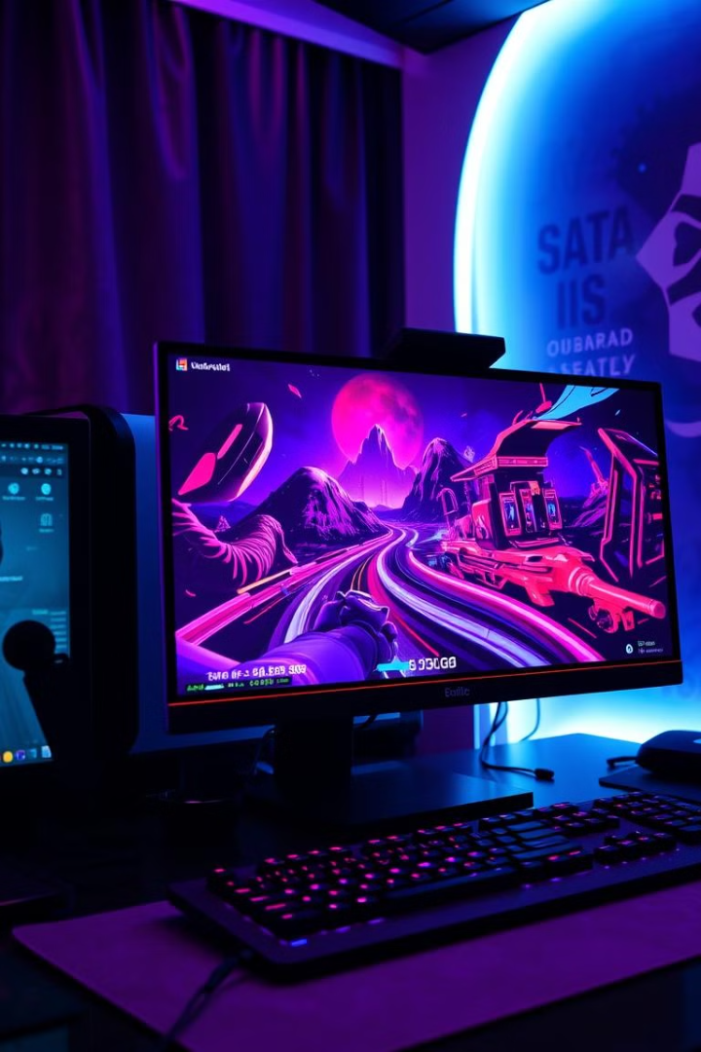
创意潜能：
Stimulate your creative potential
1
Create a personal website
Learn web design, create your online visiting card。
2
Develop video games
Realize your game creativity, become a game developer.
3
Construct practical Apps
Develop fully functional applications and solve daily problems.
4
Master PRD writing
Learn PRDs and prepare for future projects.

Slide 4

零门槛：No prior knowledge required
No foundation needed
Passion is the best starting point
There's no need to prior experience or knowledge, we go step-by-step
Come join us if you're interested! You're READY as long as you have the passion
Persistence is victory
Exceeding expectations harvest
Keep your enthusiasm, and the achievements will come to you.
You get to obtain new skills, and make new friends with the same goal. SO GO FOR IT

Slide 5

探索之旅：Explore the Limitless
1
Welcoming Atmosphere
We welcome everyone interested to join!
2
Collaborating Environment
Here, you can grow with your friends and improve together.
3
Creativity with no boundaries
Let your creativity fly, and overcome the impossible
4
Starting point for the future
This, could be your first step into the programming world, or the door to your future career

